Slide 1
JPMorgan Chase

Slide 2
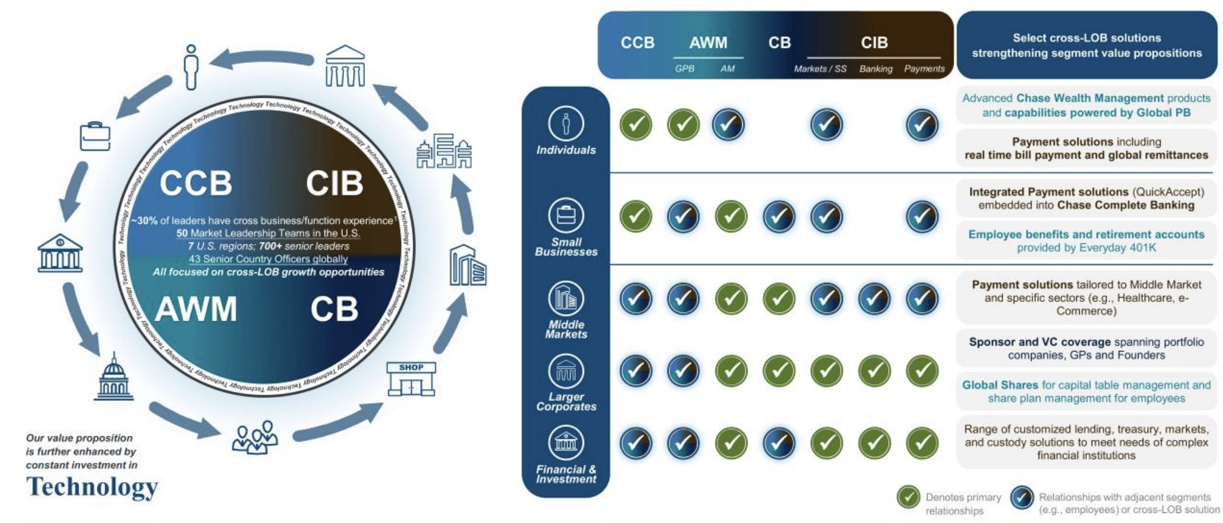

Community & Client Banking (CCB) — retail banking.
Commercial & Investment Banking (CIB) — corporations, governments, institutional investors.
Asset & Wealth Management (AWM) — includes Asset Mgmt and Private Banking.
Lori Beer (CIO), Teresa Heitsenrether (CDAO), Mary Erdoes (CEO of AWM)

Slide 3

JPMC’s Governance Journey
What has JPMC’s GenAI experience been?

Slide 4

Why Don’t Bans Don’t Work?
What would be better?

Slide 5
Complementary Assets
How do you provide a ‘better’ solution than vanilla ChatGPT?
Importance of Avoiding Lock-in (for now)

Slide 6
‘Good’ vs. ‘Bad’ Use Cases
Key GenAI applications at JPMC:
What are the common features of these use cases? Would a ‘data science for all’ agent be a good idea?

Slide 7
Risk Management
What is a High-Risk Use Case Here?
How did JPMC ‘Govern’ New Use Cases / Deployments of Gen AI?
Do You See Deeper Problems with ‘Over-reliance’ on LLMs / Agents?
Notes:
Humans grow complacent quickly — need incentive structures for verification… no incentive to pay attention if the model is correct 99% of the time. Res[onsibility and ownership for errors is an issue… this is a company system, so the company is partly at fault.

Slide 8
People Management
What are social/people risks and how do we overcome them?

Slide 9

What is Sufficient Performance?
PlanningGPT had 90-96% accuracy. Is that tolerable?

Slide 10
Questions?

